Slide 1
Tableau Data Bootcamp

Slide 2

Agenda
Introduction
Data Science
What is Tableau?
Chart Type
Dashboard Flow
Hands on! Build 4 sheets and a Dashboard

Slide 3
What is Data Science?
Notes:
We’re going to start things a little differently today. We’re going to do an art project. There should be paper and pens at everyone’s seat. When I say go, I want you to draw a picture of your neighbor, in 60 seconds. Ready, set, go.
How did you feel? What was going through your head? Were you nervous? Apprehensive? Did you apologize to your neighbor? Did you think, are we really doing this?
Why does the idea of making a simple sketch make us so uncomfortable? It’s not technically challenging. Why is it so hard?
(60-90 seconds)

Slide 4
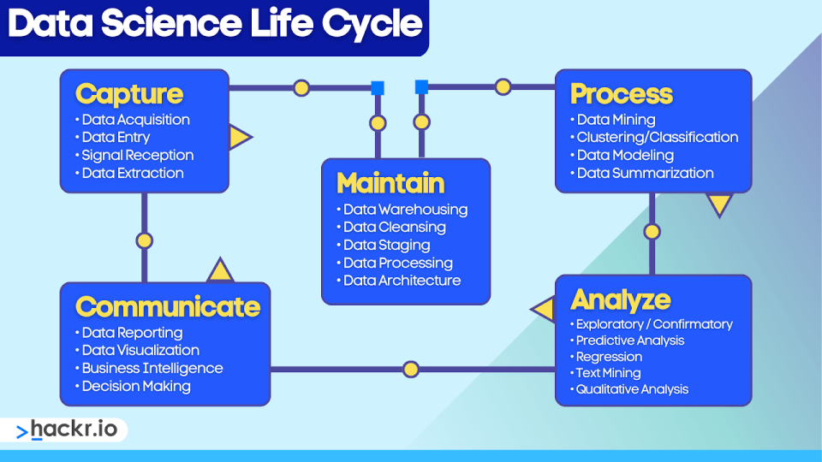

Slide 5

What is Tableau?
Notes:
You can blame this guy.
This is Robert McKim. He was an engineering professor at Stanford in the 1960s and helped found the Stanford Design School. His research focused on creativity and how to foster it. He would do this same art project with his students, at the beginning of each semester.
Outside of art projects for adults, one of the main takeaways from his research was quite simple and profound. Adults on the whole, are embarrassed to share ideas with peers. But clearly, we’re not born this way. Our apprehension builds over time.
As we get older, we grow uncomfortable with sharing things early and often. One of the things we often hear in business these days as it relates to Tableau is that I’ve got this Excel workbook and I need to recreate the same thing in Tableau. Sometimes we don’t need to reinvent the wheel but more times than not we don’t challenge ourselves out of the current status.

Slide 6
Chart Type – What questions are you trying to answer?
Notes:
One of the biggest challenges people face – how do I display my data in a meaningful way that isn’t just a crosstab. In this section we will review some common but not all chart types and explore if they are conveying the correct message.

Slide 7
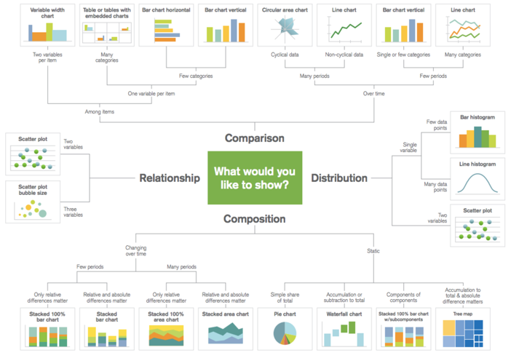
Do I have the right chart?
Notes:
A common mistake that I hear many people make is that they choose the chart type that they want. For example, declaring that they want a bar chart or a line graph vs spending time exploring their data, understanding the story they want to tell, and choosing a chart type that supports their analysis.
Take a look at the charts on your dashboard.. What are you trying to do?
Comparison – are you comparing one or more variable?
Relationship – are you showing a connection or correlation between two or more variables?
Composition – are you showing a change over time and/or parts to a whole?
Distribution – are you attempting to identify outliers and trends?
We are going to take the next few minutes to review some common chart types and explore if they are trying to answer the intended question.
Additional resources:
https://public.tableau.com/profile/josh.weyburne#!/vizhome/CookBook/VizCookbook
https://public.tableau.com/en-us/gallery/visual-vocabulary
https://public.tableau.com/views/TheTableauChartCatalog/TableauChartExamples?:embed=y&:display_count=yes&:origin=viz_share_link&:showVizHome=no#1
https://public.tableau.com/profile/bbc.audiences#!/vizhome/BBCAudiencesTableauStyleGuide/MoreInfo2
Call to action: ensure every participant has their own Tableau Public site and is subscribed to the viz of the day as we review the above resources. Invite people to follow along and bookmark these links.

Slide 8
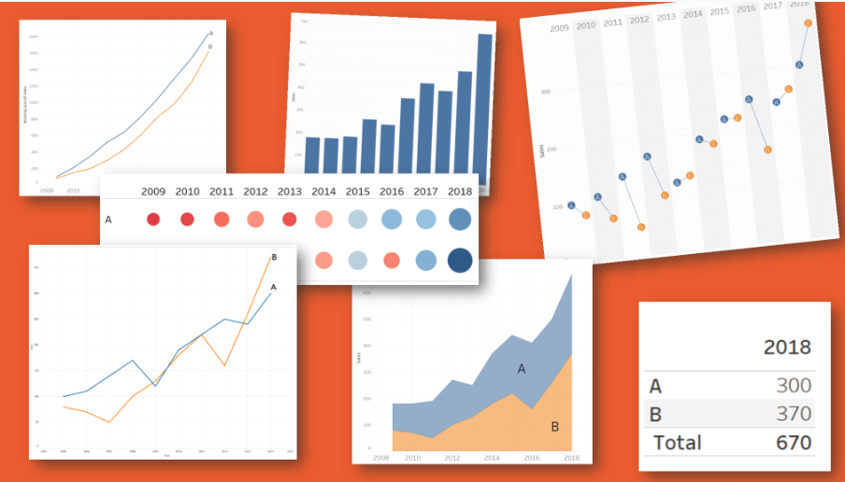
Choosing a Chart Type
Notes:
One of the biggest challenges people face – how do I display my data in a meaningful way that isn’t just a crosstab. In this section we will review some common but not all chart types and explore if they are conveying the correct message.
There are five primary types of visual mappings that content creators and consumers should understand:
Comparison, represented as a bar
Spatial, represented as a map
Temporal, represented as a line
Compare two measures, represented as a scatterplot
Precise number, represented as a text table
Line — Viewing trends in data over time. Examples: Stock price change over a five-year period, website page views during a month, revenue growth by quarter.
Bar — Comparing data across categories. Examples: Volume of shirts in different sizes, website traffic by origination site, percent of spending by department.
Heat Map — Showing the relationship between two factors. Examples: Segmentation analysis of target market, product adoption across regions, sales leads by individual rep.
Highlight Table — Providing detailed information on heat maps. Examples: The percent of a market for different segments, sales numbers in a particular region, population of cities in different years.
Treemap — Showing hierarchical data as a proportion of a whole. Examples: Storage usage across computer machines, managing the number and priority of technical support cases, comparing fiscal budgets between years.
Gantt — Showing duration over time. Examples: Project timeline, duration of a machine’s use, availability of players on a team.
Bullet — Evaluating performance of a metric against a goal. Examples: Sales quota assessment, actual spending vs. budget, performance spectrum (great/good/poor).
Scatterplot — Investigating the relationship between different variables. Examples: Male versus female likelihood of having lung cancer at different ages, technology early adopters’ and laggards’ purchase patterns of smart phones, shipping costs of different product categories to different regions.
Histogram — Understanding the distribution of your data. Examples: Number of customers by company size, student performance on an exam, frequency of a product defect.
Symbol maps — Use for totals rather than rates. Be careful, as small differences will be hard to see. Examples: Number of customers in different geographies.
Area maps — Use for rates rather than totals. Use sensible base geography. Examples: Rates of internet-usage in certain geographies, house prices in different neighborhoods.
Box-and-Whisker — Showing the distribution of a set of a data. Examples: Understanding your data at a glance, seeing how data is skewed towards one end, identifying outliers in your data.

Slide 9
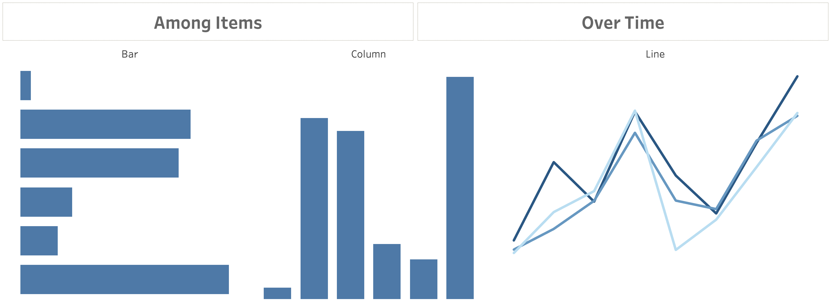
Comparison
Notes:
Comparison charts are designed to set one variable apart from another
These charts also display how the two variables interact with each other.
They can compare items or one another or show differences over time.

Slide 10
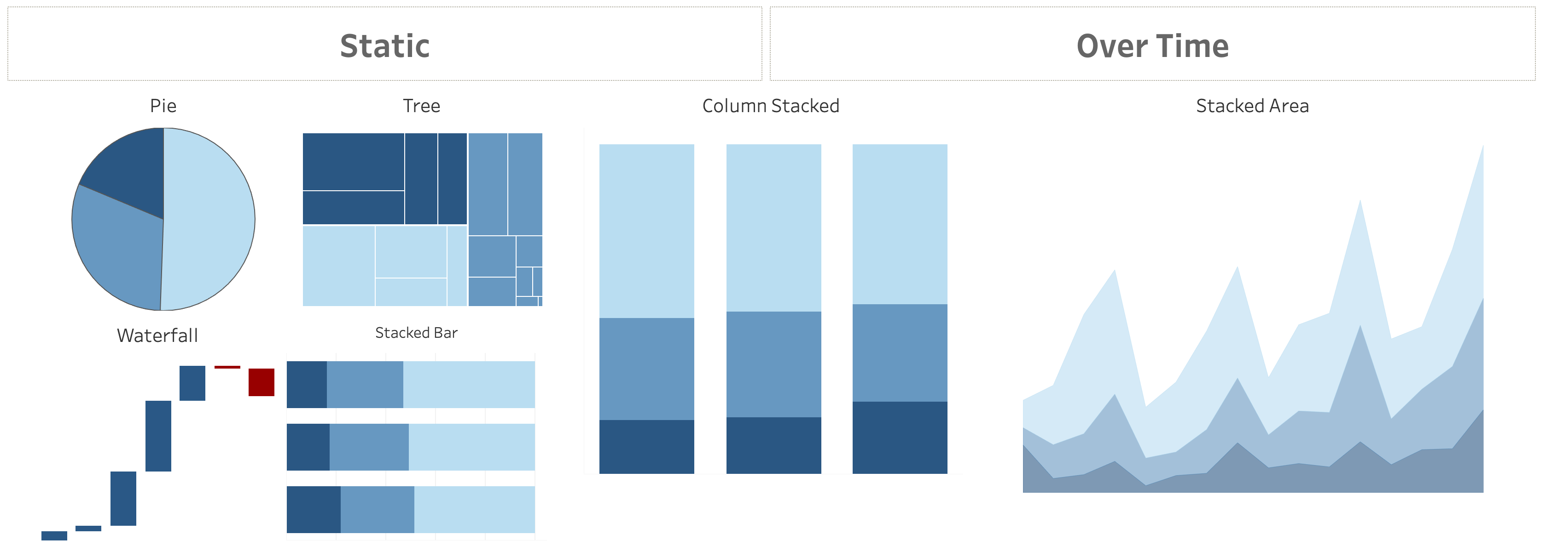
Composition
Notes:
Composition charts are used to display parts of a whole and change over time.
Pie charts callout: friends don’t let friends use pie charts (or 3D charts)… but if you must, use when comparing no more than 3 variables at a time.
Audience participation opportunity: why don’t we love pie or 3D charts when performing visual analysis?
Answer: We are not as good at noticing area and angle, and those just so happen to be the two main aspects of a pie chart.
https://interworks.com/blog/rcurtis/2018/01/19/friends-dont-let-friends-make-pie-charts/

Slide 11
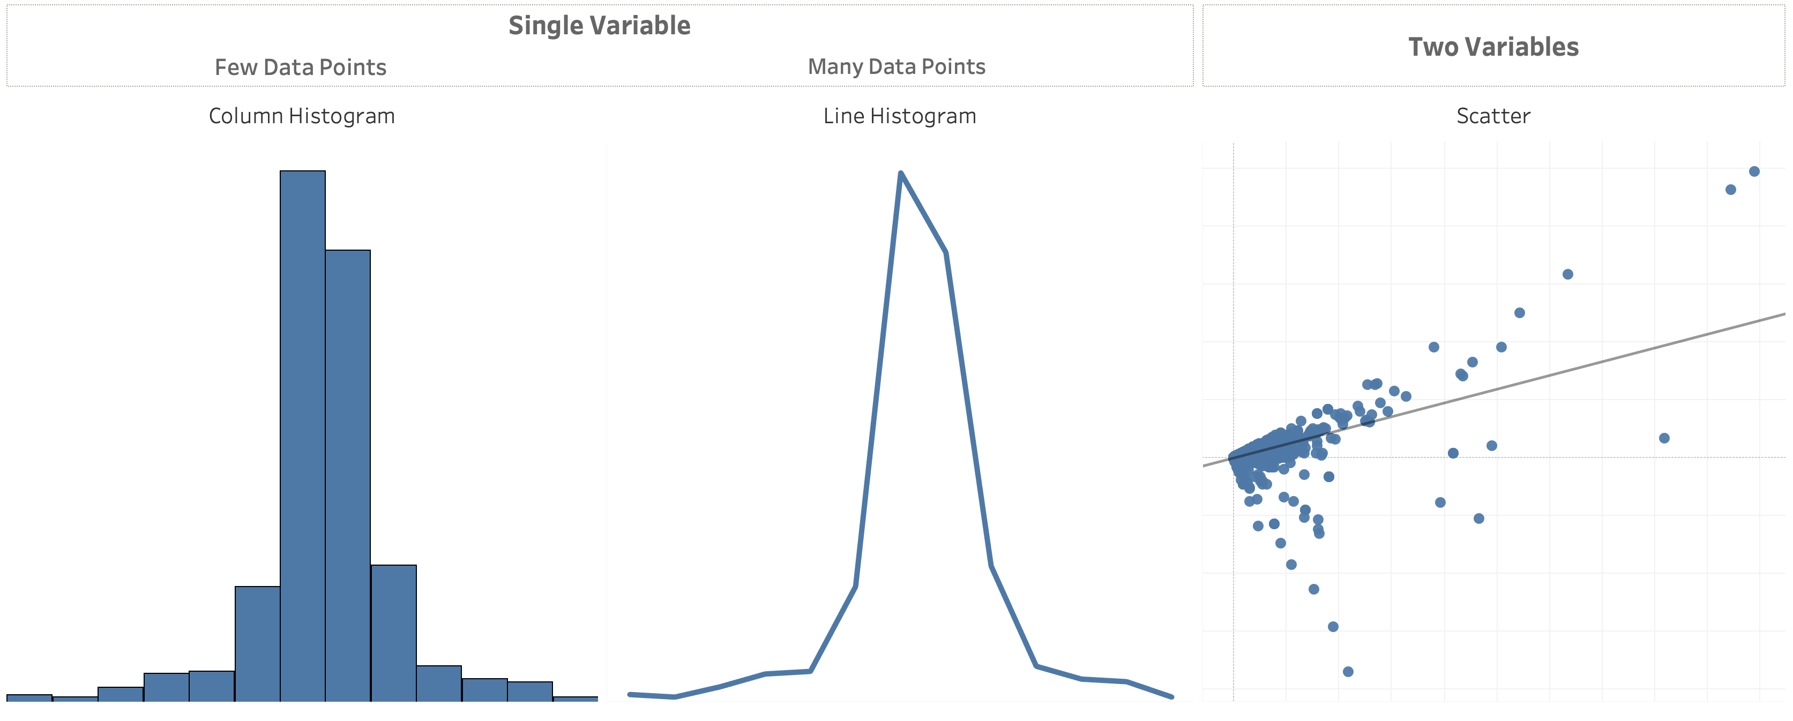
Distribution
Notes:
Distribution charts are used to show how variables are distributed over time, helping identify outliers and trends.

Slide 12
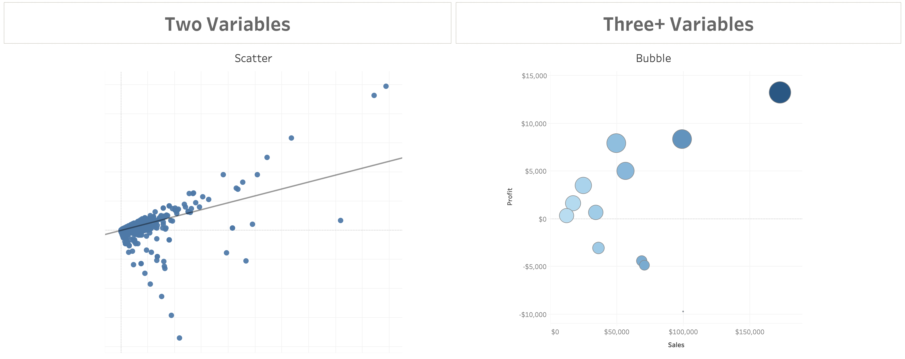
Relationship
Notes:
Relationship charts are used to show a connection or correlation between two or more variables.
When thinking about the right chart type for the question your dashboard is trying to answer, consider these additional resources:
Additional resources from Public:
Tableau Cookbook – navigate to a line chart, ask if anyone knows who the creator named is? (swag opportunity for participant)
BBC Style Guide
100 chart types
Call to action: ensure every participant has their own Tableau Public site and is subscribed to the viz of the day

Slide 13
Dashboard Flow

Slide 14
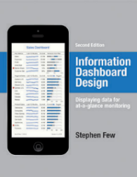
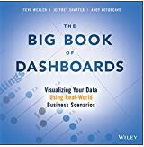
What is a dashboard?
“A dashboard is a visual display of data used to monitor conditions and/or facilitate understanding”
“A dashboard is a visual display of the most important information needed to achieve one or more objectives; consolidated and arranged on a single screen so the information can be monitored at a glance.”
Big Book of Dashboards (2017)
Stephen Few (2004)
Notes:
Plenty of definitions. Here’s one from Stephen Few. And if you haven’t read his Info Dash Design book – you must!
Right info to the right audience in the right medium so they can digest the information in the shortest time possible.

Slide 15
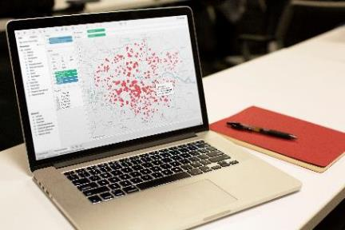
What makes a good dashboard?
Answers a set of questions
Follows a flow and invites interactivity
Condensed; primarily in the form of summaries and exceptions
Specific to and customized for the dashboard’s audience and objectives
Provides appropriate text for clarity and direction, if needed
Makes strategic use of color
Notes:
When it comes to visual best practices, there aren’t any hard and fast rules, such as “do this and never do that.” It isn’t a black and white process. There are, however, guidelines that make sense most of the time. Many of these derive from studies done on how we as humans process things like color, shape, and size. When you really understand the concepts driving these guidelines, only then should you break them.

Slide 16
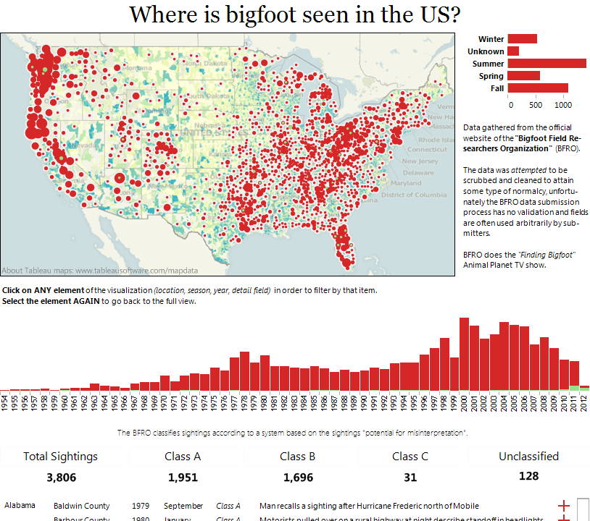
Layout Top Left:
Notes:
Let’s have a quick look on how the top left (and title) control the message
The message is the geographical distribution. What if we want the trend over time to be the message? How would we change the title and the graphics?

Slide 17
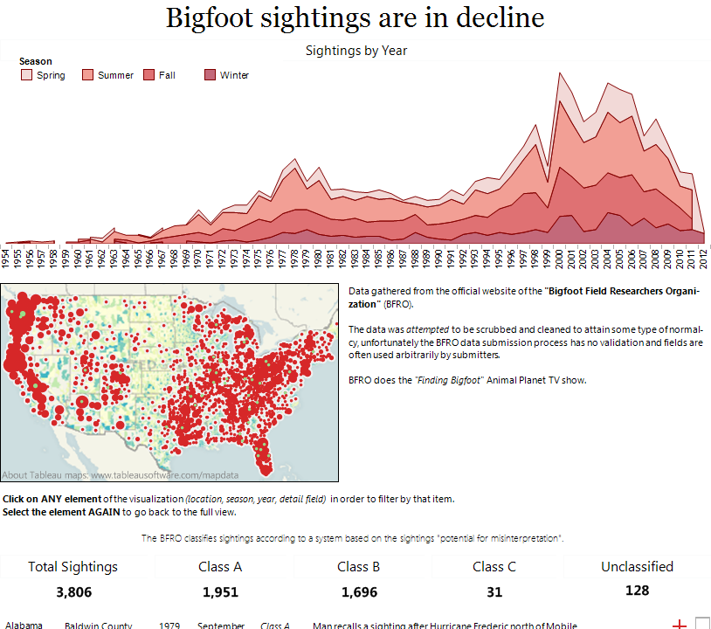
Notes:
Now we have a totally different message with exactly the same data – I’ve moved the time series to the top, and included the season data too. With this and the title, the dashboard’s message is completely different.

Slide 18
Inverted Pyramid
Most Newsworthy Info
Who? What? When? Where? Why? How?
Important Details
Other General Info
Notes:
This is a metaphor used by journalist to illustrate how information should be prioritized and structured in text. The widest part at the top represents the most substantial, interesting, and important information that the writer means to convey, illustrating that this kind of material should head the article, while the tapering lower portion illustrates that other material should follow in order of diminishing importance.
This metaphor holds true for a dashboard – the most important, newsworthy information should be at the top and the importance of information should filter down.

Slide 19
Does your dashboard pass the 5 second test?
Most important view is on top or top left
Legends are near their views
Avoid multiple color schemes
Uses 5 or fewer views (charts)

Slide 20
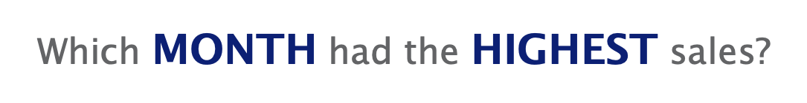
Notes:
As a designers in the reporting space, it is our responsibility to develop dashboards that are easy to understand. By understanding basic pre-attentive attributes and applying them to our workbook designs, we are able to control what our audience sees and how quickly they digest the information.
Before I get into some of the specifics of these attributes, let me show you a quick example of what I mean…
In this exercise we are going to take 3 seconds to try and identify which month has the highest number of sales for the year….
Are we ready?
Make it easier… Click

Slide 21
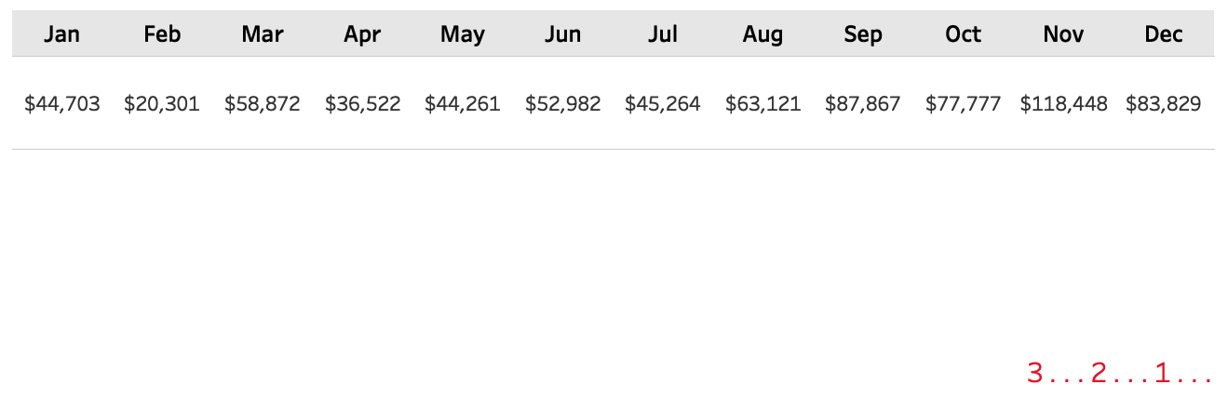

Slide 22

Notes:
Who can tell me which month had the highest number of sales?

Slide 23
Notes:
We are going to do this again but this time I want you to not just find one but the Top three performing months.
Are we ready?

Slide 24
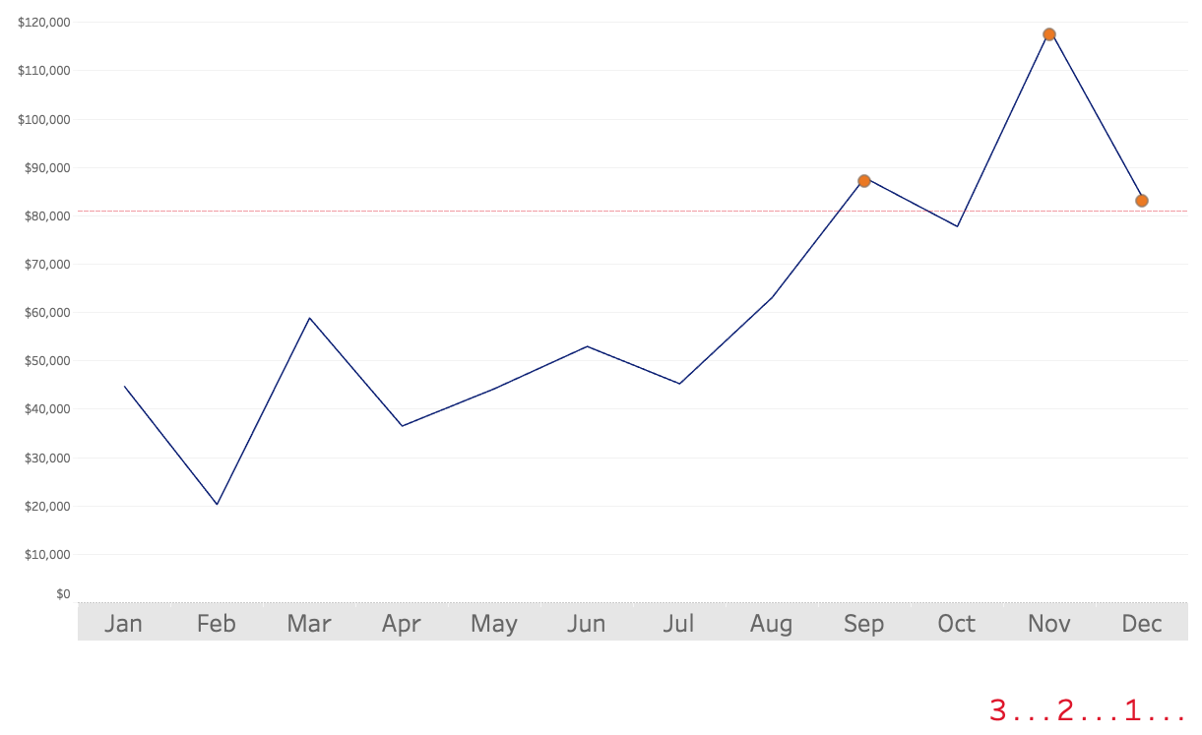
Notes:
Make it easier… Click

Slide 25

Notes:
How many of you were able to identify the top 3 performing months?

Slide 26
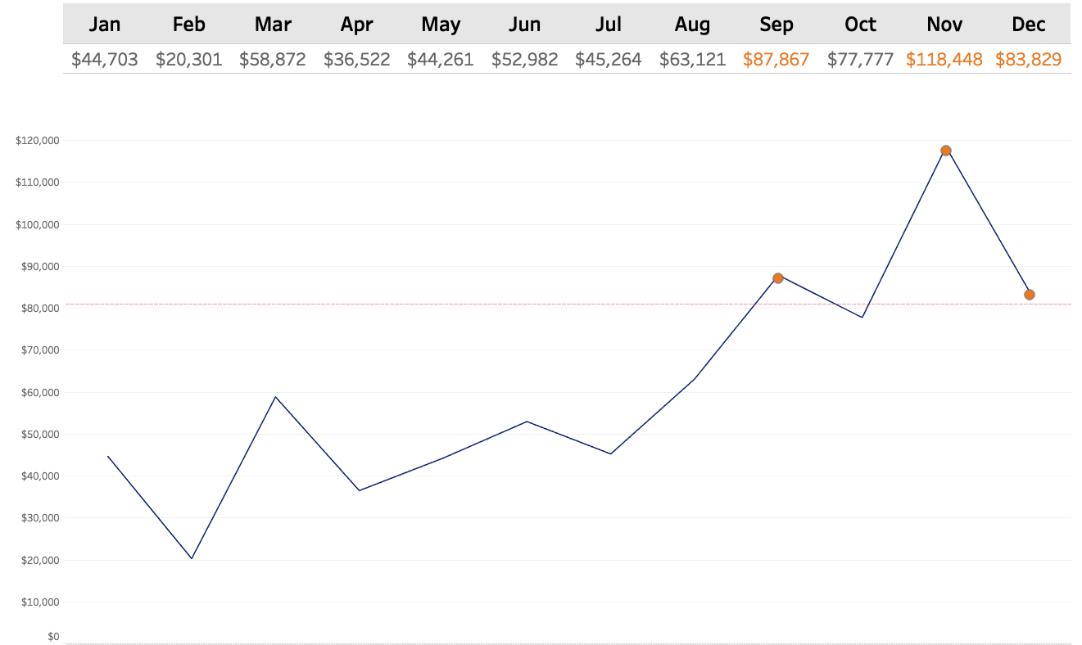
Notes:
So by visualizing the data and incorporating a few key pre-attentive attributes (like shape and color) I was able to effectively draw your eyes to the key places on the page where I wanted you to look.
Not only were you able to quickly identify data points of importance, you were also able to draw many other conclusions like: sales are steadily climbing, last 1/2 of the year out performed the first half.
The reason why we visualize data is so we can communicate information faster and make is easier to understand.

Slide 27
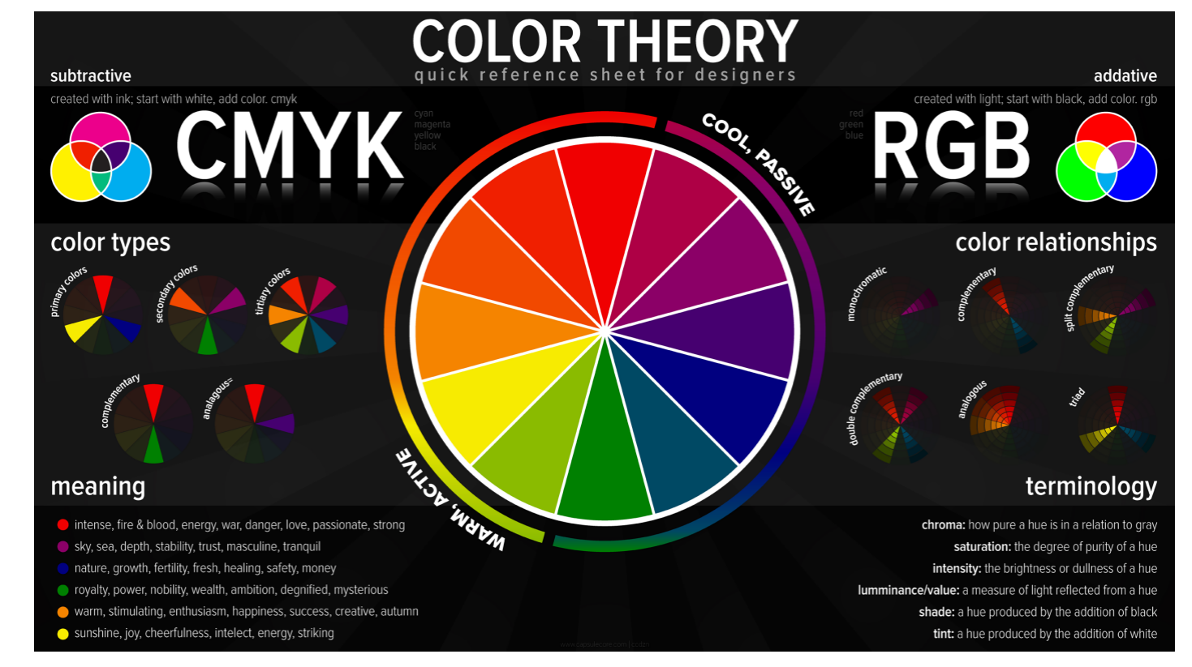
COLOR
Notes:
The Color wheel helps you understand how colors relate or don’t relate to each other.
Colors next to each other share similar values, and colors opposite from each other don’t. When you’re choosing your hues, which I’ll talk about next, this is what you want to be referencing.
Complementary colors are any two colors which are directly opposite each other, such as red and green and red-purple and yellow-green.
Choose Complimentary colors for contrast
Analogous Colors for flow and association
Triadic colors for balance.

Slide 28
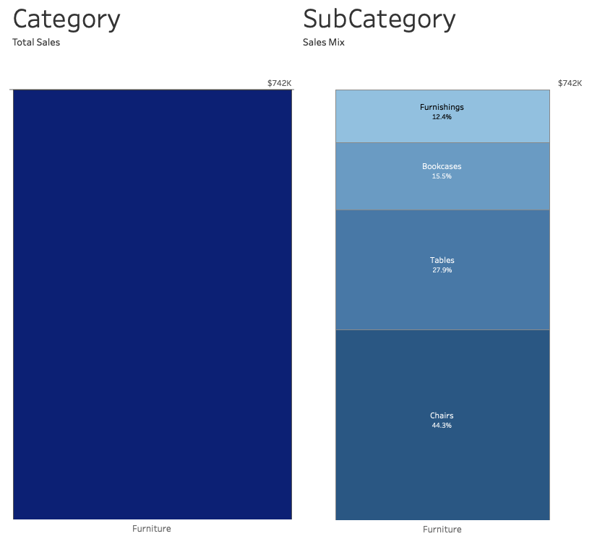
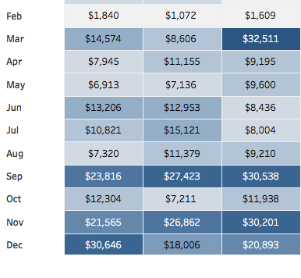
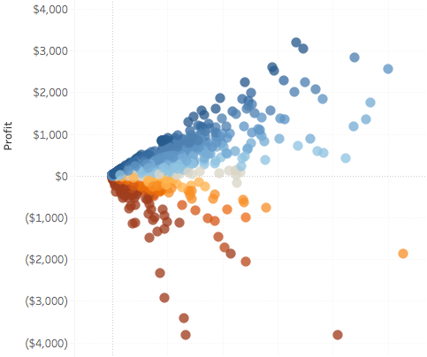
Using Saturation
Relationship /Sequence
Quantitative / Numerical
Notes:
Use color consistently, so we understand its meaning
Always use the same color to represent the same meaning or category throughout all of your vizzes.
Color is one of the quickest and easiest ways to visualize relationship throughout a dashboard.
Visually group items of association by assigning various saturation to attributes correlating to the parent hue.

Slide 29
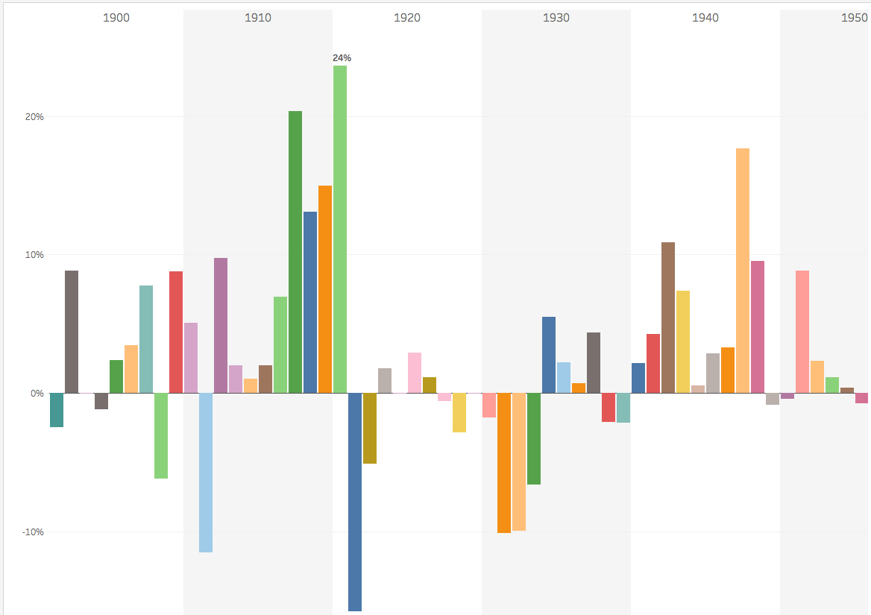
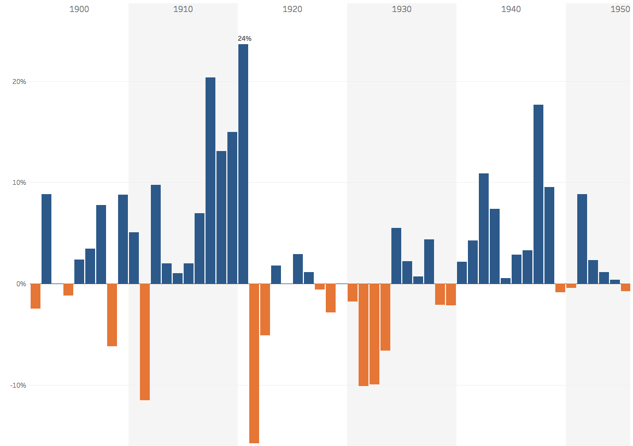
A word about color:
Be Careful Not To Become The Next
Vincent van Gogh
Notes:
Everyone loves colorful art… just not in a report.
Color should be used to highlight key data indicators and allow easier definition of the overall data story.

Slide 30
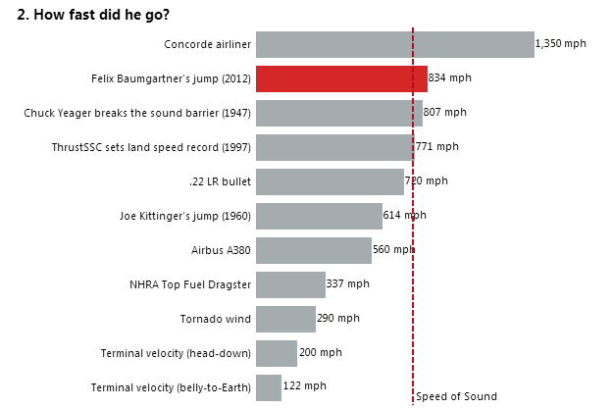
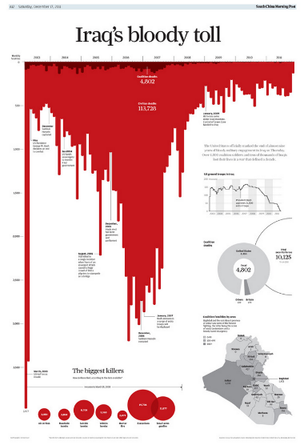
Do your titles capture attention?
Notes:
The title should get inside the users brain and spark interest. It can excite, scare, be controversial, drive curiosity, invoke emotion, educate or be intriguing.
Bigfoot sightings are in decline – not super attention grabbing but in the title supports the context below by showing the sightings over time
How fast did he go? – My attention is grabbed. The design of the dashboard draws me to the red bar (prior context this is Felix Baumgartner’s jump to Earth from a helium balloon). I can quickly rank and compare how fast he went vs other common dimensions. The reference line is a nice touch as it adds an additional element of comparison.
Iraq’s bloody toll –this dashboard was published in South China’s Morning Post by Simon Scar– the word choice in the title is matched by the attention capturing bar chart – yes this is just an inverted bar chart made to look like blood.

Slide 31
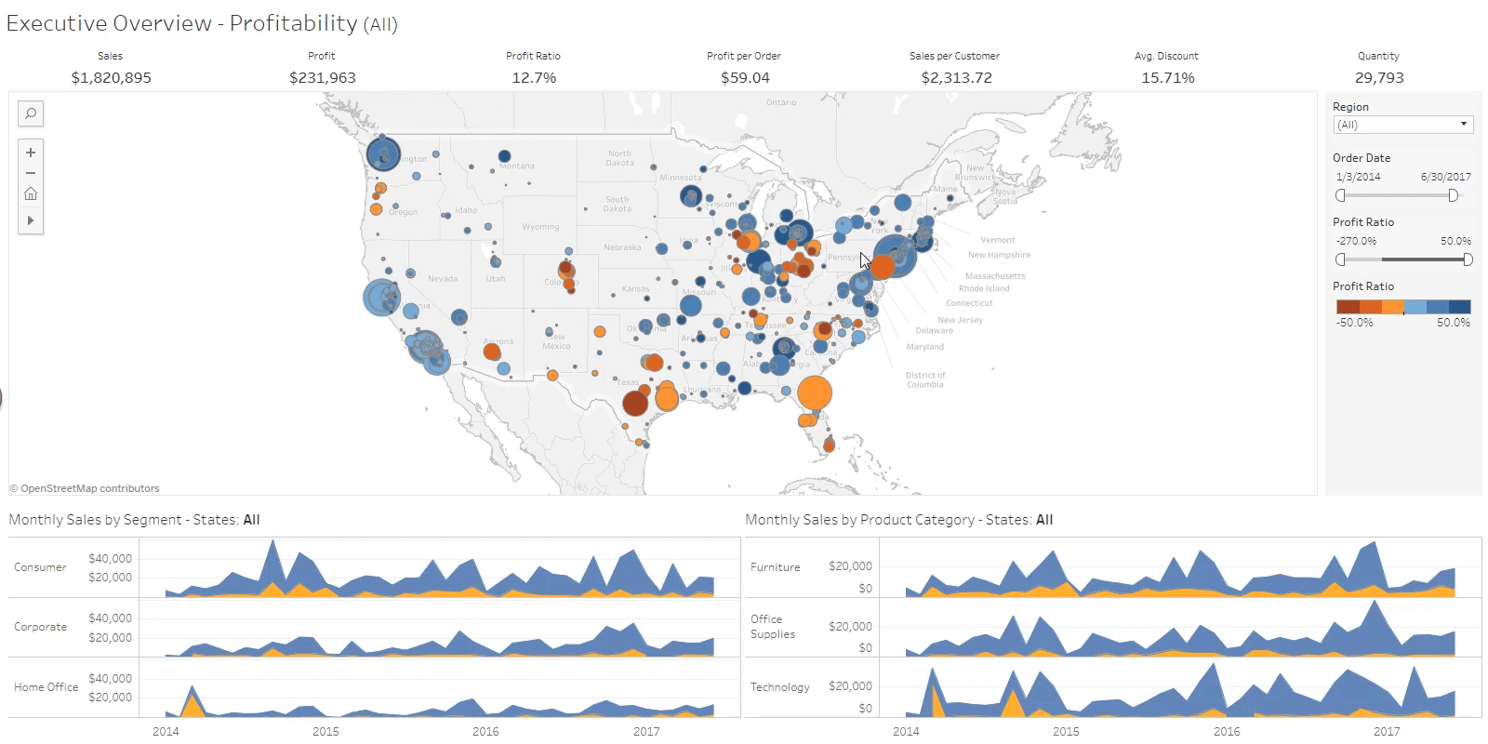
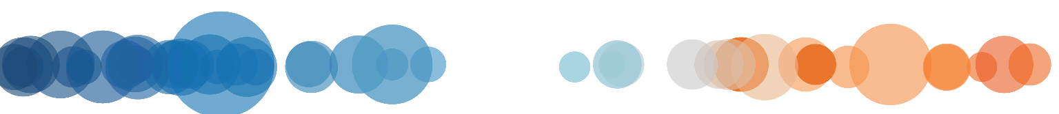
Notes:
(GIF will play animation when in presenter mode)

Slide 32
One last thing that is guaranteed to make your dashboards amazing…

Slide 33

Notes:
Full Page Image w Color Bar

Slide 35
Notes:
Full Page Image w Color Bar

